Slide 1


Big Data Seminar – BIA 678
Class 3
“One Size Fits None” – Michael Stonebreaker
http://cs.brown.edu/~ugur/fits_all.pdf
David Belanger PhD
Senior Research Fellow – Stevens Institute of Technology
dbelange@stevens.edu

Slide 2
Class 3 Outline
Administrative Stuff:
Formation of teams
Saturday, Feb 23 – EAS 230 --- only 56 people
Saturday, Mar 2 – EAS 222 – 80 or so people
Guest Speaker: YiFan Hu (Yahoo Research): Visualization & Machine Learning. April 30.
Activity #1 – Discussion of Readings
MapReduce Paper
GFS Paper
Assignment #1
Spark: A Unified Engine for Big Data Processing – ACM Communications 2016 – on CANVAS or from Library
Apache Hadoop Yarn - https://www.cse.ust.hk/~weiwa/teaching/Fall15-COMP6611B/reading_list/YARN.pdf and on CANVAS.
Activity #2 – Finish Introduction – questions?
Activity #3 – Discussion of Cloudera Downloads
Activity #4 – Discussion of HDFS and Map Reduce
Activity #5 – Short discussion of RDD/Datasets and Data Management

Slide 3
Term Paper Topics Spring 2018
Title
Real Time Stream Processing, Analysis and Architecture
BIG DATA IN TELECOM SECTOR
Big Data in Human Resource
Recommender Systems and Big Data
Big Data and Blockchain Make a Powerful Couple for New Trend
Evolution in Master Data Management (MDM) to Address the Needs of the Big Data Revolution
Data Visualization in The Era of Big Data
Big Data in Banking & Finance

Slide 4
Term Paper Topics Spring 2018 - 2
A Survey of Music Recommender Systems
Heart Failure Prediction based on Multi-Layer Perceptron Classifier
Data Mining Technology and Its Application in E-commerce
BIG DATA IN MANUFACTURING
Big Data In Baseball
Time series analysis using the hybrid of artificial neural network and Autoregressive integrated moving average (ARIMA) model
HEDGE FUNDS AND BIG DATA
BIG DATA IN FOOD INDUSTRY
Big Data and Machine Learning
Big Data in Deep Learning: How Big data is empowering AI and Machine Learning
Data Migration from Relational Database to NoSQL Database
Impact of Big Data on Video Games
Accelerating Data Management Systems with Machine Learning
Big Data in NBA
A Survey of Big Data in Sports
DATA VISUALIZATION IN THE WORLD OF BIG DATA
An Overview of Current RNA Sequencing Methods
Big Data Application: Medical Care Science
A Survey on Web Usage Mining

Slide 5
Cloud and Distributed Computing
Use of cloud based storage and computational resources has become pervasive
For processing of big datasets
Cloud characteristics
Provide a scalable standard environment
On-demand computing
Pay as you need
Dynamically scalable
Cheaper
Source: Apache Hadoop and Spark: Introduction and Use Cases for Data Analytics; Afzal Godil, ITL, NIST

Slide 6
Data Processing and Machine learning Methods
Data processing (third trend)
Traditional ETL (extract, transform, load)
Data Stores (HBase, ……..)
Tools for processing of streaming,
multimedia & batch data
Machine Learning (fourth trend)
Classification
Regression
Clustering
Collaborative filtering
Data Processing ETL (extract, transform, load)
Big Datasets
Machine
Learning
Distributed Computing
Source: Apache Hadoop and Spark: Introduction and Use Cases for Data Analytics; Afzal Godil, ITL, NIST

Slide 7
Hadoop Ecosystem
Enable Scalability
on commodity hardware
Handle Fault Tolerance
Can Handle a Variety of Data type
Text, Graph, Streaming Data, Images,…
Shared Environment
Provides Value
Cost
Source: Apache Hadoop and Spark: Introduction and Use Cases for Data Analytics; Afzal Godil, ITL, NIST

Slide 8
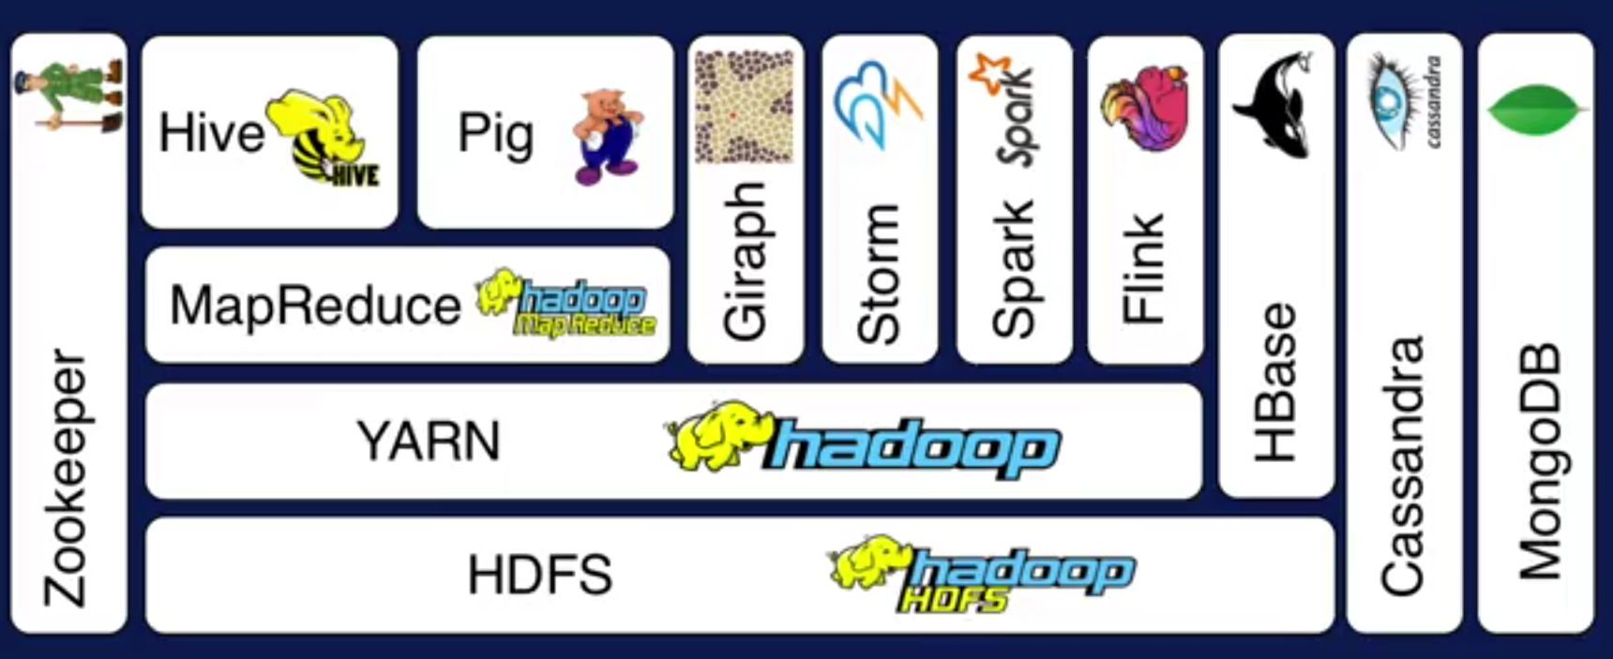
Hadoop Ecosystem
A
Layer Diagram
B
C
D
Source: Apache Hadoop and Spark: Introduction and Use Cases for Data Analytics; Afzal Godil, ITL, NIST

Slide 9
Apache Hadoop Basic Modules
Hadoop Common
Hadoop Distributed File System (HDFS)
Hadoop YARN
Hadoop MapReduce
Other Modules: Zookeeper, Impala, Oozie, etc.
Spark, Storm, Tez, etc.
HBase
Non-relational Database
Pig
Scripting
Hive
SQL Like Query
MapReduce
Distributed Processing
Others
Distributed Processing
Yarn
Resource Manager
HDFS Distributed File System (Storage)
Source: Apache Hadoop and Spark: Introduction and Use Cases for Data Analytics; Afzal Godil, ITL, NIST
Notes:
YARN is resource manager

Slide 10
Hadoop HDFS
Hadoop distributed File System (based on Google File System (GFS) paper, 2004)
Serves as the distributed file system for most tools in the Hadoop ecosystem
Scalability for large data sets
Reliability to cope with hardware failures
HDFS good for:
Large files
Streaming data
Not good for:
Lots of small files
Random access to files
Low latency access
Single Hadoop cluster with 5000 servers and 250 petabytes of data
Source: Apache Hadoop and Spark: Introduction and Use Cases for Data Analytics; Afzal Godil, ITL, NIST

Slide 11
Design of Hadoop Distributed File System (HDFS)
Master-Slave design
Master Node
Single NameNode for managing metadata
Slave Nodes
Multiple DataNodes for storing data
Other
Secondary NameNode as a backup
Source: Apache Hadoop and Spark: Introduction and Use Cases for Data Analytics; Afzal Godil, ITL, NIST

Slide 12
HDFS Architecture
NameNode keeps the metadata, the name, location and directory
DataNode provide storage for blocks of data
Client
NameNode
Secondary NameNode
DataNode
DataNode
DataNode
DataNode
DataNode
DataNode
DataNode
DataNode
Heartbeat, Cmd, Data
Source: Apache Hadoop and Spark: Introduction and Use Cases for Data Analytics; Afzal Godil, ITL, NIST

Slide 13
HDFS
What happens; if node(s) fail?
Replication of Blocks for fault tolerance
File
B1
B2
B3
B4
Node
Node
Node
Node
B1
B2
B4
B3
Node
Node
Node
Node
B1
B3
B1
B2
B4
Node
Node
Node
Node
B4
B3
B1
B2
Source: Apache Hadoop and Spark: Introduction and Use Cases for Data Analytics; Afzal Godil, ITL, NIST

Slide 14
HDFS
HDFS files are divided into blocks
It’s the basic unit of read/write
Default size is 64MB, could be larger (128MB)
Hence makes HDFS good for storing larger files
HDFS blocks are replicated multiple times
One block stored at multiple location, also at different racks (usually 3 times)
This makes HDFS storage fault tolerant and faster to read
Source: Apache Hadoop and Spark: Introduction and Use Cases for Data Analytics; Afzal Godil, ITL, NIST

Slide 15
Few HDFS Shell commands
Create a directory in HDFS
hadoop fs -mkdir /user/godil/dir1
List the content of a directory
hadoop fs -ls /user/godil
Upload and download a file in HDFS
hadoop fs -put /home/godil/file.txt /user/godil/datadir/
hadoop fs -get /user/godil/datadir/file.txt /home/
Look at the content of a file
Hadoop fs -cat /user/godil/datadir/book.txt
Many more commands, similar to Unix
Source: Apache Hadoop and Spark: Introduction and Use Cases for Data Analytics; Afzal Godil, ITL, NIST

Slide 16
HBase
NoSQL data store build on top of HDFS
Based on the Google BigTable paper (2006)
Can handle various types of data
Stores large amount of data (TB,PB)
Column-Oriented data store
Big Data with random read and writes
Horizontally scalable
Source: Apache Hadoop and Spark: Introduction and Use Cases for Data Analytics; Afzal Godil, ITL, NIST

Slide 17
HBase, not to use for
Not good as a traditional RDBMs (Relational Database Model)
Transactional applications
Data Analytics
Not efficient for text searching and processing
Source: Apache Hadoop and Spark: Introduction and Use Cases for Data Analytics; Afzal Godil, ITL, NIST

Slide 18
MapReduce: Simple Programming for Big Data
Based on Google’s MR paper (2004)
MapReduce is simple programming paradigm for the Hadoop ecosystem
Traditional parallel programming requires expertise of different computing/systems concepts
examples: multithreads, synchronization mechanisms (locks, semaphores, and monitors )
incorrect use: can crash your program, get incorrect results, or severely impact performance
Usually not fault tolerant to hardware failure
The MapReduce programming model greatly simplifies running code in parallel
you don't have to deal with any of above issues
only need to create, map and reduce functions
Source: Apache Hadoop and Spark: Introduction and Use Cases for Data Analytics; Afzal Godil, ITL, NIST

Slide 19
Map Reduce Paradigm
Map and Reduce are based on functional programming
Apply function Map: Apply a function to all the elements of List list1=[1,2,3,4,5]; square x = x * x list2=Map square(list1) print list2 -> [1,4,9,16,25] | Reduce: Combine all the elements of list for a summary list1 = [1,2,3,4,5]; A = reduce (+) list1 Print A -> 15
Input
Map
Reduce
Output
Source: Apache Hadoop and Spark: Introduction and Use Cases for Data Analytics; Afzal Godil, ITL, NIST

Slide 20
MapReduce Word Count Example
I am Sam
Node
(I,1)
(am,1)
(Sam,1)
Node
File
Map
Reduce
B
E
B
A
Sam I am
Node
Shuffle
&
Sort
Node
C
Map
Reduce
D
A
F
(I,2)
(am,2)
(Sam,2)
(…,..)
(..,..)
………
Node
Node
Map
Reduce
C
G
(I,1)
(am,1)
(Sam,1)
………
Node
Node
Map
Reduce
D
H
Source: Apache Hadoop and Spark: Introduction and Use Cases for Data Analytics; Afzal Godil, ITL, NIST

Slide 21
Shortcomings of MapReduce
Forces your data processing into Map and Reduce
Other workflows missing include join, filter, flatMap, groupByKey, union, intersection, …
Based on “Acyclic Data Flow” from Disk to Disk (HDFS)
Read and write to Disk before and after Map and Reduce (stateless machine)
Not efficient for iterative tasks, i.e. Machine Learning
Only Java natively supported
Support for others languages needed
Only for Batch processing
Interactivity, streaming data
Source: Apache Hadoop and Spark: Introduction and Use Cases for Data Analytics; Afzal Godil, ITL, NIST

Slide 22
One Solution is Apache Spark
A new general framework, which solves many of the short comings of Hadoop MapReduce
It capable of leveraging the Hadoop ecosystem, e.g. HDFS, YARN, HBase, S3, …
Has many other workflows, i.e. join, filter, flatMapdistinct, groupByKey, reduceByKey, sortByKey, collect, count, first…
In-memory caching of data (for iterative, graph, and machine learning algorithms, etc.)
Native Scala, Java, Python, and R support
Supports interactive shells for exploratory data analysis - REPL
Spark API is relatively simple to use
Developed at AMPLab UC Berkeley, now by Apache and Databricks.com
Source: Apache Hadoop and Spark: Introduction and Use Cases for Data Analytics; Afzal Godil, ITL, NIST

Slide 23
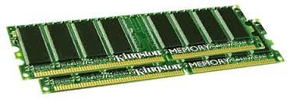
Spark Uses Memory instead of Disk
Hadoop: Use Disk for Data Sharing
HDFS
read
HDFS
Write
HDFS
read
HDFS
Write
Iteration1
Iteration2
Spark: In-Memory Data Sharing
HDFS read
Iteration1
Iteration2
Source: Apache Hadoop and Spark: Introduction and Use Cases for Data Analytics; Afzal Godil, ITL, NIST

Slide 24
Sort competition
 | Hadoop MR Record (2013) | Spark Record (2014)
Data Size | 102.5 TB | 100 TB
Elapsed Time | 72 mins | 23 mins
# Nodes | 2100 | 206
# Cores | 50400 physical | 6592 virtualized
Cluster disk throughput | 3150 GB/s (est.) | 618 GB/s
Network | dedicated data center, 10Gbps | virtualized (EC2) 10Gbps network
Sort rate | 1.42 TB/min | 4.27 TB/min
Sort rate/node | 0.67 GB/min | 20.7 GB/min
Spark, 3x faster with 1/10 the nodes
Sort benchmark, Daytona Gray: sort of 100 TB of data (1 trillion records)
http://databricks.com/blog/2014/11/05/spark-officially-sets-a-new-record-in-large-scale-sorting.html

Slide 25
Apache Spark
Apache Spark supports data analysis, machine learning, graphs, streaming data, etc. It can read/write from a range of data types and allows development in multiple languages.
Scala, Java, Python, R, SQL
DataFrames
ML Pipelines
Spark SQL
Spark Streaming
MLlib
GraphX
Spark Core
Data Sources
Hadoop HDFS, HBase, Hive, Apache S3, Streaming, JSON, MySQL, and HPC-style (GlusterFS, Lustre)
Source: Apache Hadoop and Spark: Introduction and Use Cases for Data Analytics; Afzal Godil, ITL, NIST

Slide 26
HDFS – Hadoop File System Source: http://hadoop.apache.org/docs/current/hadoop-project-dist/hadoop-hdfs/HdfsUserGuide.html#Shell_Commands
HDFS is the primary distributed storage used by Hadoop.
It is instantiated in a cluster of computers including:
NameNode: File System Metadata
Data Nodes: Actual Data

Slide 27
HDFS – Hadoop File System Architecture Source:http://hadoop.apache.org/docs/current/hadoop-project-dist/hadoop-hdfs/HdfsDesign.html
HDFS Assumptions and Goals
Hardware failure is the norm rather than the exception
Optimized for Streaming Data Access: High throughput vs low latency
Optimized for large datasets, e.g. millions of files.
Simple Coherency Model:
Write once – Read Many
Write as append planned
Moving Computation is easier than Moving Data
Portable across heterogeneous hardware and software platforms.

Slide 28
HDFS – Hadoop File System Architecture Fault Tolerance Source:http://hadoop.apache.org/docs/current/hadoop-project-dist/hadoop-hdfs/HdfsDesign.html
Failure is the norm rather than exception
A HDFS instance may consist of thousands of server machines, each storing part of the file system’s data.
Since we have huge number of components and that each component has non-trivial probability of failure means that there is always some component that is non-functional.
Detection of faults and quick, automatic recovery from them is a core architectural goal of HDFS.

Slide 29

HDFS – Hadoop File System Architecture Source:http://hadoop.apache.org/docs/current/hadoop-project-dist/hadoop-hdfs/HdfsDesign.html

Slide 30
HDFS – Hadoop File System Architecture Source:http://hadoop.apache.org/docs/current/hadoop-project-dist/hadoop-hdfs/HdfsDesign.html
HDFS NameNodes and DataNodes
HDFS has a master/slave architecture.
An HDFS cluster consists of a single NameNode, a master server that manages the file system namespace and regulates access to files by clients.
NameNode:
Manages Namespace operations (open, close, rename, assign blocks to datanodes.
Maps blocks to data nodes
DataNodes:
Usually one per physical node in the cluster
A file is split into one or more blocks and set of blocks are stored in DataNodes.
DataNodes: serves read, write requests, performs block creation, deletion, and replication upon instruction from Namenode.

Slide 31
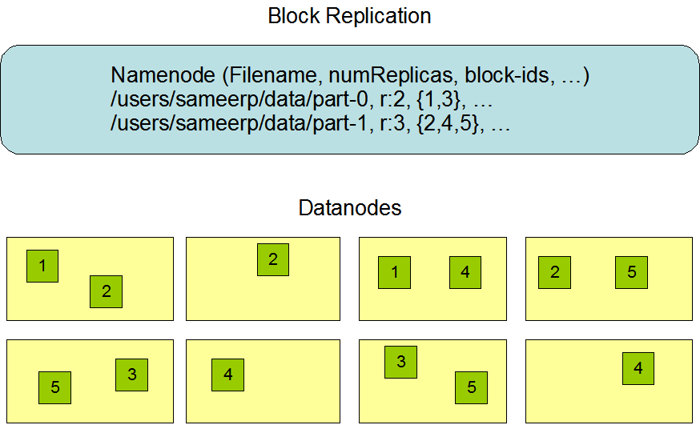
HDFS – Hadoop File System Architecture Fault Tolerance Source:http://hadoop.apache.org/docs/current/hadoop-project-dist/hadoop-hdfs/HdfsDesign.html

Slide 32
HDFS – Hadoop File System Commands Source:http://hadoop.apache.org/docs/current/hadoop-project-dist/hadoop-hdfs/
http://hadoop.apache.org/docs/current/hadoop-project-dist/hadoop-hdfs/HDFSCommands.html
HDFS provides Java API for application to use.
Python access is also used in many applications.
A C language wrapper for Java API is also available.
A HTTP browser can be used to browse the files of a HDFS instance.

Slide 33
HDFS – Hadoop File System Commands Source:http://hadoop.apache.org/docs/current/hadoop-project-dist/hadoop-hdfs/
http://hadoop.apache.org/docs/current/hadoop-project-dist/hadoop-hdfs/HDFSCommands.html
HDFS organizes its data in files and directories.
It provides a command line interface called the FS shell that lets the user interact with data in the HDFS.
The syntax of the commands is similar to bash and csh.
Example: to create a directory /foodir
/bin/hadoop dfs –mkdir /foodir
Browser interface is also available to view the namespace.

Slide 34
Map Reduce Patent
Google granted US Patent 7,650,331, January 2010
System and method for efficient large-scale data processing A large-scale data processing system and method includes one or more application-independent map modules configured to read input data and to apply at least one application-specific map operation to the input data to produce intermediate data values, wherein the map operation is automatically parallelized across multiple processors in the parallel processing environment. A plurality of intermediate data structures are used to store the intermediate data values. One or more application-independent reduce modules are configured to retrieve the intermediate data values and to apply at least one application-specific reduce operation to the intermediate data values to provide output data.

Slide 35
Design Algorithms using MapReduce
Design Constraints
No communication or synchronization between mappers or reducers
No global state or data store
May relax this constraints using Apache Zookeeper, a global store
Data are only shuffled by reduce key, i.e., Key in the reduce step.
Design for Efficiency and Scalability
Minimize the amount of data shuffled from mappers to reducers; networking IO
Balance workloads on each machine; MR job finishes when the slowest finishes
Minimize the number of MapReduce jobs; input and output networking IO
Avoid limiting the number of mappers or reducers; horizontal scalability
Avoid assuming data to be accommodated in main memory; horizontal scalability
ww2.cs.mu.oz.au/~rui/subjects/.../STDM_6_MapReduce.ppt Rui Zhang – Univ of Melborne

Slide 36
Map/Reduce In a Slide (In this case Hadoop Map/Reduce)
Init
Hadoop divides the input file stored in HDFS into “splits” (typically the size of an HDFS block) and assigns every split to a different “mapper”, trying to assign every split to the mapper where the split physically resides (Locality).
Mapper
Locally, Hadoop reads the split of the mapper line by line.
Locally, Hadoop calls the method map() of the mapper for every line passing it as the key value parameters
The mapper computes its application logic and emits other key/value pairs.
Shuffle and Sort
Locally, Hadoop’s partioner divides the emitted output of the mapper (key/value pairs) into partitions, each of which is sent to a different reducer. All like keys are in the same partition.
Locally, Hadoop collects all the different partitions received from the mappers, and sorts them by key.
Reducer
Locally, Hadoop reads the aggregated partitions line by line.
Locally, Hadoop calls the reduce() method on the reducer for every line of the input (key/value pairs)
The reducer computes its application logic and emits other key/value pairs
Locally, Hadoop writes the emitted output pairs to HDFS.

Slide 37
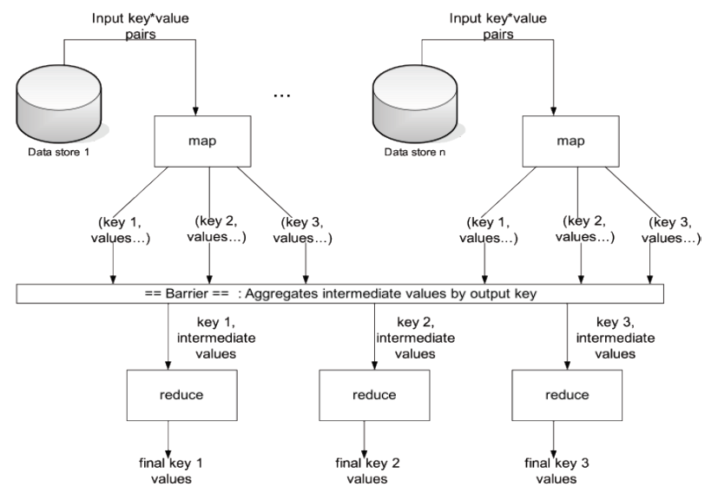
Map Reduce the Big Picture

Slide 38
MapReduce The “Hello World” of MapReduce
Count the number of occurrences of a word in a large amount of input data
the cat sat on the mat
the aardvark sat on the sofa
Solution
Map<search word, 1>
Reduce<word, total count>

Slide 39
Map Reduce the Big Picture

Slide 40
Another Simple Map/Reduce Example Matrix Transpose
The Problem: Given a matrix A, find its Transpose A^{T} .
For example, given the matrix A =
1 5 2 7
5 7 2 8
2 1 7 5
Write a map/reduce algorithm to calculate the Transpose A^{T} =
1 5 2
5 7 1
2 2 7
7 8 5

Slide 41
Another Simple Map/Reduce Example Matrix Transpose
The Problem: Given a matrix A, find its Transpose A^{T} .
For example, given the matrix A =
1 5 2 7
5 7 2 8
2 1 7 5
Write a map/reduce algorithm to calculate the Transpose A^{T} =
1 5 2
5 7 1
2 2 7
7 8 5
Question 1: What is the input to the mappers:

Slide 42
Another Simple Map/Reduce Example Matrix Transpose
The Problem: Given a matrix A, find its Transpose A^{T} .
For example, given the matrix A =
1 5 2 7
5 7 2 8
2 1 7 5
Write a map/reduce algorithm to calculate the Transpose A^{T} =
1 5 2
5 7 1
2 2 7
7 8 5
Question 1: What is the input to the mappers:
Key = row/column index; or if stored by rows, row index
Value = value of that position in the matrix.
For simplicity, let’s assume entire rows on each local machine.

Slide 43
Another Simple Map/Reduce Example Matrix Transpose
The Problem: Given a matrix A, find its Transpose A^{T} .
For example, given the matrix A =
1 5 2 7
5 7 2 8
2 1 7 5
Write a map/reduce algorithm to calculate the Transpose A^{T} =
1 5 2
5 7 1
2 2 7
7 8 5
Question 2: What key/value pairs should the mappers output?

Slide 44
Another Simple Map/Reduce Example Matrix Transpose
The Problem: Given a matrix A, find its Transpose A^{T} .
For example, given the matrix A =
1 5 2 7
5 7 2 8
2 1 7 5
Write a map/reduce algorithm to calculate the Transpose A^{T} =
1 5 2
5 7 1
2 2 7
7 8 5
Question 2: What key/value pairs should the mappers output, why?
Map(1, [1 5 2 7]) => <1:(1,1)> <2:(1,5)> <3:(1,2)> <4:(1,7)>
Map(2, [5 7 2 8]) => <1:(2,5)> <2:(2,7)> <3:(2,2)> <4:(2,8)>
Map(3, [2 1 7 5]) => <1:(3,2)> <2:(3,1)> <3:(3,7)> <4:(3,5)>

Slide 45
Another Simple Map/Reduce Example Matrix Transpose
The Problem: Given a matrix A, find its Transpose A^{T} .
For example, given the matrix A =
1 5 2 7
5 7 2 8
2 1 7 5
Write a map/reduce algorithm to calculate the Transpose A^{T} =
1 5 2
5 7 1
2 2 7
7 8 5
Question 3: What are the partitions after Sort and Shuffle?

Slide 46
Another Simple Map/Reduce Example Matrix Transpose
The Problem: Given a matrix A, find its Transpose A^{T} .
For example, given the matrix A =
1 5 2 7
5 7 2 8
2 1 7 5
Write a map/reduce algorithm to calculate the Transpose A^{T} =
1 5 2
5 7 1
2 2 7
7 8 5
Question 3: What are the partitions after Sort and Shuffle?
{1: <1,1>, <2,5>, <3,2>}
{2: <1,5>, <2,7>, <3,1>}
{3: <1,2>, <2,2>, <3,7>}
{4: <1,7>, <2,8>, <3,5>}

Slide 47
Another Simple Map/Reduce Example Matrix Transpose
The Problem: Given a matrix A, find its Transpose A^{T} .
For example, given the matrix A =
1 5 2 7
5 7 2 8
2 1 7 5
Write a map/reduce algorithm to calculate the Transpose A^{T} =
1 5 2
5 7 1
2 2 7
7 8 5
Question 4: What does the reducer do?

Slide 48
Another Simple Map/Reduce Example Matrix Transpose
The Problem: Given a matrix A, find its Transpose A^{T} .
For example, given the matrix A =
1 5 2 7
5 7 2 8
2 1 7 5
Write a map/reduce algorithm to calculate the Transpose A^{T} =
1 5 2
5 7 1
2 2 7
7 8 5
Question 4: What does the reducer do?
{1: <1,1>, <2,5>, <3,2>} => {1: (1,5,2)}
{2: <1,5>, <2,7>, <3,1>} => {2: (5,7,1)}
{3: <1,2>, <2,2>, <3,7>} => {3: (2,2,7)}
{4: <1,7>, <2,8>, <3,5>} => {4: (7,8,5)}

Slide 49
Map/Reduce Example TopN Following several slides adapted, or copied, from: http://www.slideshare.net/andreaiacono/mapreduce-34478449
The problem is to list the “Top N” words in a large text file.
First question: How would you do this without distribution?
Class gives answers
Second question: Can it be done using map/reduce, and if so what would the mappers and reducers look like?
First, the input to the mappers must be key/value pairs.
Second, the mappers must output key/value pairs to Shuffle and Sort.
Third, the reducers must input key/value pair partitions and provide output for reporting.

Slide 50
Map/Reduce Example TopN
The problem is to list the “Top N” words in a large text file.
First question: How would you do this without distribution?
Class gives answers
Second question: Can it be done using map/reduce, and if so what would the mappers and reducers look like?
First, the input to the mappers must be key/value pairs.
<file offset or line number, text line>
Second, the mappers must output key/value pairs to Shuffle and Sort.
Third, the reducers must input key/value pair partitions and provide output for reporting.

Slide 51
Map/Reduce Example TopN
The problem is to list the “Top N” words in a large text file.
First question: How would you do this without distribution?
Class gives answers
Second question: Can it be done using map/reduce, and if so what would the mappers and reducers look like?
First, the input to the mappers must be key/value pairs.
Second, the mappers must output key/value pairs to Shuffle and Sort.
<word, 1>
Third, the reducers must input key/value pair partitions and provide output for reporting.

Slide 52
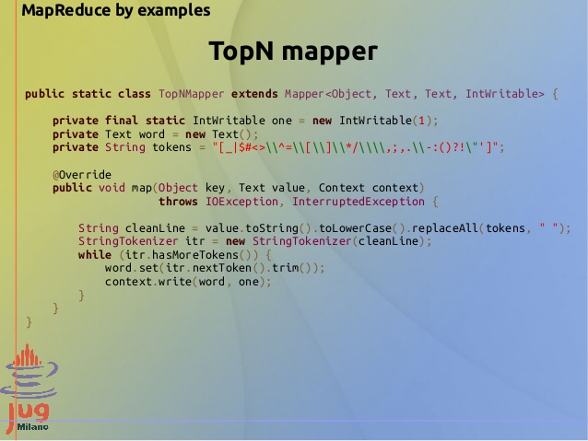

Slide 53
Map/Reduce Example TopN
The problem is to list the “Top N” words in a large text file.
First question: How would you do this without distribution?
Class gives answers
Second question: Can it be done using map/reduce, and if so what would the mappers and reducers look like?
First, the input to the mappers must be key/value pairs.
Second, the mappers must output key/value pairs to Shuffle and Sort.
Third, the reducers must input key/value pair partitions and provide output for reporting.

Slide 54
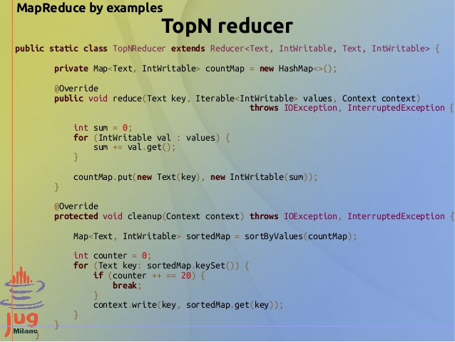

Slide 55
Map/Reduce Example TopN
The problem is to list the “Top N” words in a large text file.
First question: How would you do this without distribution?
Class gives answers
Second question: Can it be done using map/reduce, and if so what would the mappers and reducers look like?
First, the input to the mappers must be key/value pairs.
Second, the mappers must output key/value pairs to Shuffle and Sort.
Sometimes network use can be much more efficient using “combiner” logic.
Third, the reducers must input key/value pair partitions and provide output for reporting.

Slide 56
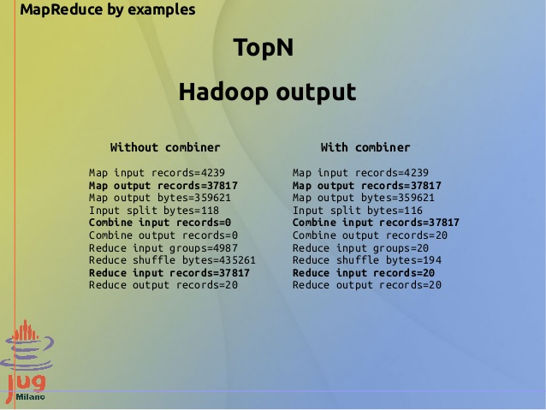

Slide 57
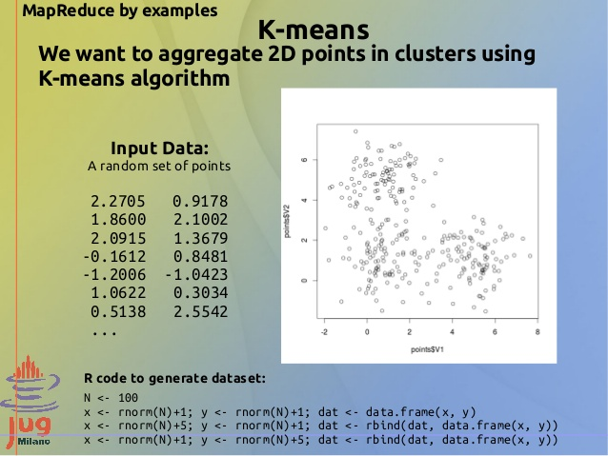

Slide 58
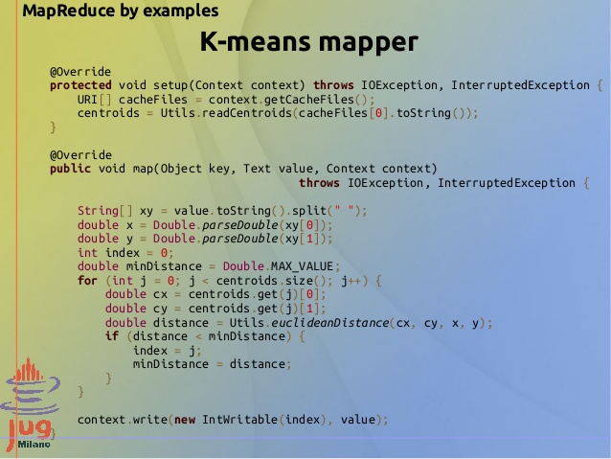

Slide 59
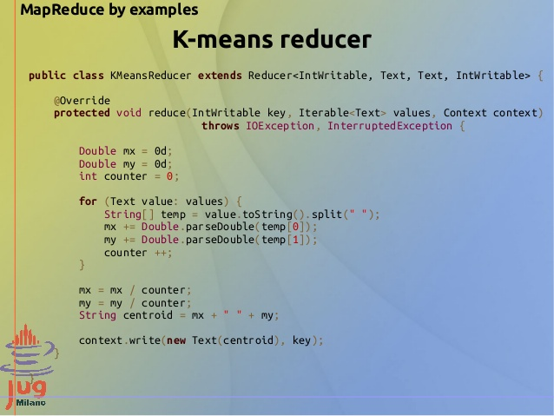

Slide 60
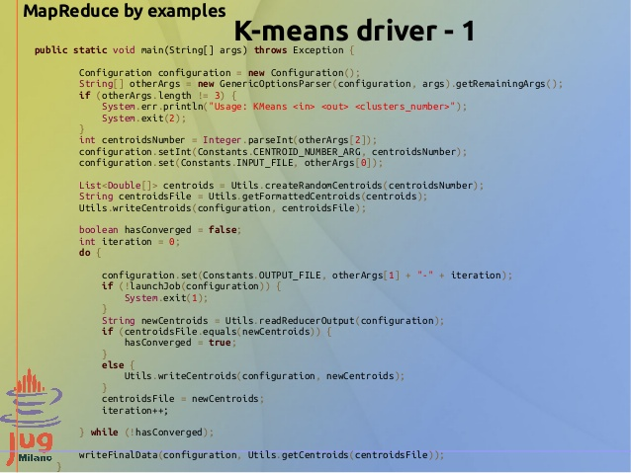

Slide 61
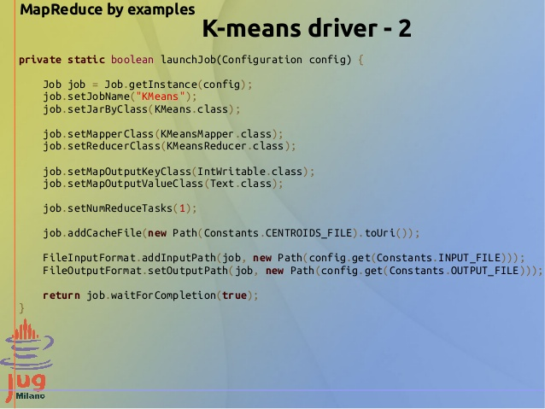

Slide 62


Slide 63
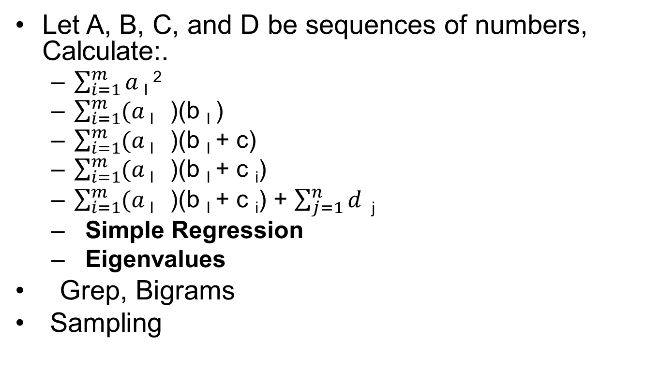
Some Map Reduce Examples
Let A, B, C, and D be sequences of numbers, Calculate:.
$\sum_{i=1}^{m}{a}$ _{I} ²
$\sum_{i=1}^{m}{(a}$ _{I} )(b _{I} )
$\sum_{i=1}^{m}{(a}$ _{I} )(b _{I} + c)
$\sum_{i=1}^{m}{(a}$ _{I} )(b _{I} + c _{i})
$\sum_{i=1}^{m}{(a}$ _{I} )(b _{I} + c _{i}) + $\sum_{j=1}^{n}{d }$ _{j}
Simple Regression
Eigenvalues
Grep, Bigrams
Sampling

Slide 64
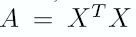
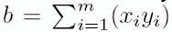
Example: Linear Regression using Least Squares
Model:
Goal:
Solution: Given m examples: (x1, y1), (x2, y2), …, (xm, ym) We write a matrix X with x1, …, xm as rows, and row vector Y=(y1, y2, …ym). Then the solution is
Parallel computation:
Cut to m/num_processor pieces

Slide 65
Distributed Grep
Very popular example to explain how Map-Reduce works
Demo program comes with Nutch (where Hadoop originated)

Slide 66
Distributed Grep
For Unix guru: grep -Eh <regex> <inDir>/* | sort | uniq -c | sort -nr - counts lines in all files in <inDir> that match <regex> and displays the counts in descending order - grep -Eh 'A|C' in/* | sort | uniq -c | sort -nr - Analyzing web server access logs to find the top requested pages that match a given pattern
File 1
C
B
B
C
File 2
Result
C
A
3 C
1 A

Slide 67
Distributed Grep
Map function in this case: - input is (file offset, line) - output is either:
1. an empty list [] (the line does not match) 2. a key-value pair [(line, 1)] (if it matches) Reduce function in this case: - input is (line, [1, 1, ...]) - output is (line, n) where n is the number of 1s in the list.

Slide 68
Distributed Grep
Grep [AC]
File 1
C
B
B
C
File 2
Result
C
A
3 C
1 A
Map tasks: (0, C) -> [(C, 1)] (2, B) -> [] (4, B) -> [] (6, C) -> [(C, 1)] (0, C) -> [(C, 1)] (2, A) -> [(A, 1)]
Reduce tasks: (A, [1]) -> (A, 1) (C, [1, 1, 1]) -> (C, 3)

Slide 69
MapReduce
Jimmy Zheng
2014-01-23

Slide 70
Map Reduce the Big Picture

Slide 71
MapReduce Example 1
Count the number of occurrence of each word in a large amount of input data
the cat sat on the mat
the aardvark sat on the sofa
Solution
Map<each word, 1>
Reduce<word, total count>

Slide 72
Map Phase
Multiple mappers run in parallel, each processing a proportion of the input data
Mappers hold part of data locally to avoid network traffic
Mapper reads data in the form of key/value pairs
Emit intermediate data in form of key/value pairs if exists
MAP Input
(111, ‘the cat sat on the mat’)
(222, ‘the aardvark sat on the sofa’)
MAP Output
('the', 1), ('cat', 1), ('sat', 1), ('on', 1), ('the', 1), ('mat', 1), ('the', 1), ('aardvark', 1),('sat', 1), ('on', 1), ('the', 1), ('sofa', 1)

Slide 73
Reduce Phase
All intermediate values for a given intermediate key are combined together into a list and give to reducer
All value for one key will go to the same reducer
Reducer do calculation
Reducer emits key/value pair and write to HDFS
Reduce Input
('aardvark', [1])
('cat', [1])
('mat', [1])
('on', [1, 1])
('sat', [1, 1])
('sofa', [1])
('the', [1, 1, 1, 1])
Reduce Output
('aardvark', 1)
('cat', 1)
('mat', 1)
('on', 2)
('sat', 2)
('sofa', 1)
('the', 4)

Slide 74
(111, ‘the cat sat on the mat’)
(222, ‘the aardvark sat on the sofa’)
('the', 1), ('cat', 1), ('sat', 1), ('on', 1), ('the', 1), ('mat', 1)
('aardvark', 1),('sat', 1), ('on', 1), ('the', 1), ('sofa', 1)
('aardvark', [1]), ('cat', [1]), ('mat', [1]), ('on', [1, 1]), ('sat', [1, 1]), ('sofa', [1]), ('the', [1, 1, 1, 1])
('aardvark', [1]) ('cat', [1])
('mat', [1]) ('on', [1, 1])
('sat', [1, 1])
('sofa', [1])
('the', [1, 1, 1, 1])
('aardvark', 1), ('cat', 1), ('mat', 1), ('on', 2), ('sat', 2), ('sofa', 1), ('the', 4)

Slide 75
Java Code for Mapper
public class WordMapper extends Mapper<LongWritable, Text, Text, IntWritable> {
/*
* The map method runs once for each line of text in the input file.
*/
public void map(LongWritable key, Text value, Context context)
throws IOException, InterruptedException {
/*
* Convert the line, which is received as a Text object, to a String object.
*/
String line = value.toString();
/*
* The line.split("\\W+") call uses regular expressions to split the line up by non-word characters.
*/
for (String word : line.split("\\W+")) {
if (word.length() > 0) {
/*
* Call the write method on the Context object to emit a key and a value from the map method.
*/
context.write(new Text(word), new IntWritable(1));
}
}
}
}

Slide 76
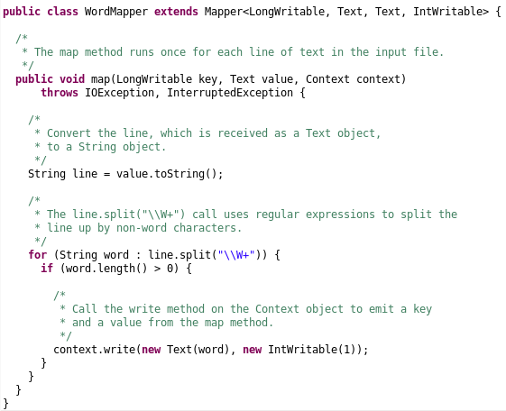
(111, ‘the cat sat on the mat’)
(222, ‘the aardvark sat on the sofa’)
('the', 1), ('cat', 1), ('sat', 1),
('on', 1), ('the', 1), ('mat', 1)
('aardvark', 1),('sat', 1), ('on', 1), ('the', 1), ('sofa', 1)
('aardvark', [1]), ('cat', [1]), ('mat', [1]), ('on', [1, 1]), ('sat', [1, 1]), ('sofa', [1]), ('the', [1, 1, 1, 1])
('aardvark', [1]) ('cat', [1])
('mat', [1]) ('on', [1, 1])
('sat', [1, 1])
('sofa', [1])
('the', [1, 1, 1, 1])
('aardvark', 1), ('cat', 1), ('mat', 1), ('on', 2), ('sat', 2), ('sofa', 1), ('the', 4)

Slide 77
Java Code for Reducer
public class SumReducer extends Reducer<Text, IntWritable, Text, IntWritable> {
/*
* The reduce method runs once for each key received from
* the shuffle and sort phase of the MapReduce framework.
* The method receives a key of type Text, a set of values of type
* IntWritable, and a Context object.
*/
public void reduce(Text key, Iterable<IntWritable> values, Context context)
throws IOException, InterruptedException {
int wordCount = 0;
/*
* For each value in the set of values passed to us by the mapper:
*/
for (IntWritable value : values) {
/*
* Add the value to the word count counter for this key.
*/
wordCount += value.get();
}
/*
* Call the write method on the Context object to emit a key
* and a value from the reduce method.
*/
context.write(key, new IntWritable(wordCount));
}
}

Slide 78
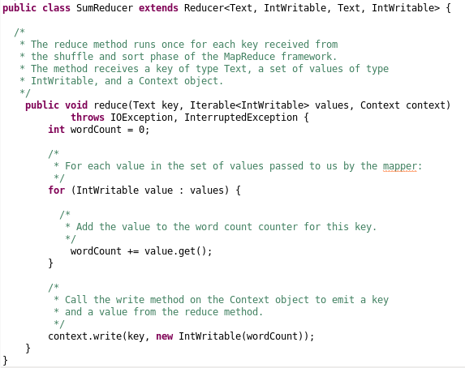
(111, ‘the cat sat on the mat’)
(222, ‘the aardvark sat on the sofa’)
('the', 1), ('cat', 1), ('sat', 1), ('on', 1), ('the', 1), ('mat', 1)
('aardvark', 1),('sat', 1), ('on', 1), ('the', 1), ('sofa', 1)
('aardvark', [1]) ('cat', [1])
('mat', [1]) ('on', [1, 1])
('sat', [1, 1])
('sofa', [1])
('the', [1, 1, 1, 1])
('aardvark', 1), ('cat', 1), ('mat', 1), ('on', 2), ('sat', 2), ('sofa', 1), ('the', 4)

Slide 79
Python Code for Mapper
#!/usr/bin/env python
import sys
# split the line into words
def read_input(file):
for line in file:
yield line.split()
# get input from standard input
data = read_input(sys.stdin)
for words in data:
# write the results to STDOUT (standard output);
for word in words:
print '%s\t%d' % (word, 1)

Slide 80
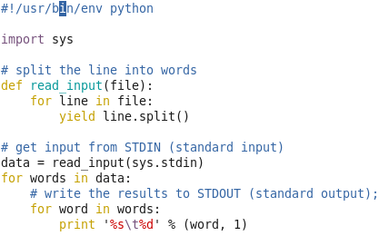
(111, ‘the cat sat on the mat’)
(222, ‘the aardvark sat on the sofa’)
('the', 1), ('cat', 1), ('sat', 1), ('on', 1), ('the', 1), ('mat', 1)
('aardvark', 1),('sat', 1), ('on', 1), ('the', 1), ('sofa', 1)
('aardvark', 1)
('cat', 1)
('mat', 1)
('sofa', 1)
('on', 1)
('on', 1)
('sat', 1)
('sat', 1)
('the', 1)
('the', 1)
('the', 1)
('the', 1)
('aardvark', 1), ('cat', 1), ('mat', 1), ('on', 2), ('sat', 2), ('sofa', 1), ('the', 4)

Slide 81
Python Code for Reducer
#!/usr/bin/env python
from itertools import groupby
from operator import itemgetter
import sys
def read_mapper_output(file):
for line in file:
yield line.rstrip().split('\t', 1) # The input format for reducer is different from Java
# read input comes from STDIN (standard input)
data = read_mapper_output(sys.stdin)
# groupby groups multiple word-count pairs by word,
# and creates an iterator that returns consecutive keys and their group:
for current_word, group in groupby(data, itemgetter(0)):
current_word_count = sum(int(count) for current_word, count in group)
print "%s\t%d" % (current_word, current_word_count)

Slide 82
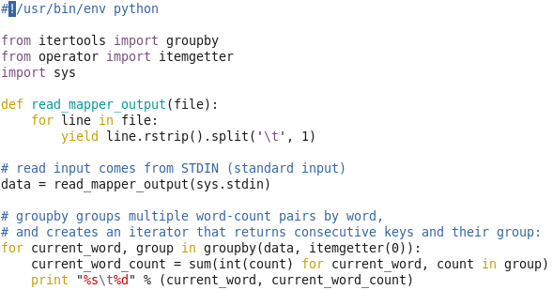
(111, ‘the cat sat on the mat’)
(222, ‘the aardvark sat on the sofa’)
('the', 1), ('cat', 1), ('sat', 1), ('on', 1), ('the', 1), ('mat', 1)
('aardvark', 1),('sat', 1), ('on', 1), ('the', 1), ('sofa', 1)
('aardvark', 1)
('cat', 1)
('mat', 1)
('sofa', 1)
('on', 1)
('on', 1)
('sat', 1)
('sat', 1)
('the', 1)
('the', 1)
('the', 1)
('the', 1)
('aardvark', 1), ('cat', 1), ('mat', 1), ('on', 2), ('sat', 2), ('sofa', 1), ('the', 4)

Slide 83
MapReduce Example 2
Calculate the average length of words in a file
the cat sat on the mat
the aardvark sat on the sofa
Solution
Map<1, each word’s length>
Reduce<1, total length>

Slide 84
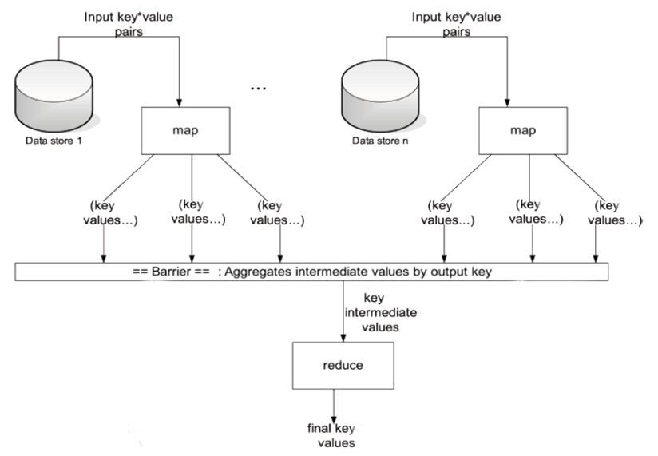
(111, ‘the cat sat on the mat’)
(222, ‘the aardvark sat on the sofa’)
(‘key’, 3), (‘key’, 3), (‘key’, 3),
(‘key’,2), (‘key', 3), (‘key', 3)
(‘key’, 8), (‘key', 3), (‘key', 2),
(‘key', 3), (‘key', 4)
(‘key', 3)
(‘key’, 3)
(‘key’, 8)
……
(‘key', 3.333)

Slide 85
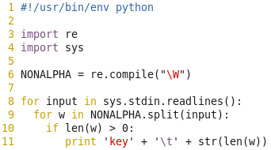
(111, ‘the cat sat on the mat’)
(222, ‘the aardvark sat on the sofa’)
(‘key’, 3), (‘key’, 3), (‘key’, 3),
(‘key’,2), (‘key', 3), (‘key', 3)
(‘key’, 8), (‘key', 3), (‘key', 2),
(‘key', 3), (‘key', 4)
(‘key', 3)
(‘key’, 3)
(‘key’, 8)
……
(‘key', 3.333)

Slide 86
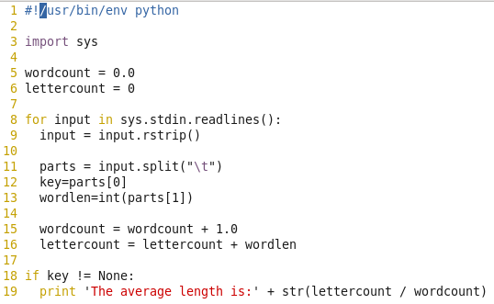
(111, ‘the cat sat on the mat’)
(222, ‘the aardvark sat on the sofa’)
(‘key’, 3), (‘key’, 3), (‘key’, 3),
(‘key’,2), (‘key', 3), (‘key', 3)
(‘key’, 8), (‘key', 3), (‘key', 2),
(‘key', 3), (‘key', 4)
(‘key', 3)
(‘key’, 3)
(‘key’, 8)
……
(‘key', 3.333)

